Slide 1
  Lesson5: Administrator

Slide 2
Lesson 5: Administrator
Administrator tab is also having following Sub Tabs
  Entity Configuration
  Processing Configuration
Notes:
Administrator tab is also having Sub Tabs as Entity Configuration and Processing Configuration

Slide 3
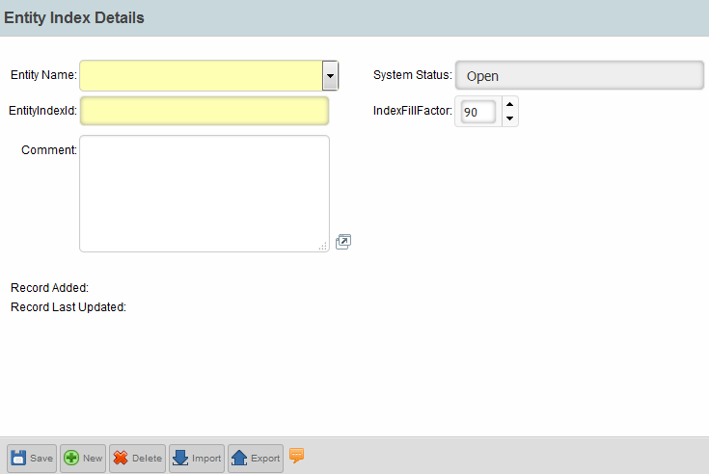
Lesson 5: Entity Configuration - Entity Index Search
Creation/Modification of Entity Index.
Administrator->Entity Configuration->Entity Index Search
Step 1:
New Users
Notes:
Let’s now understand how Entity Index can be created. Fill up mandatory fields

Slide 4

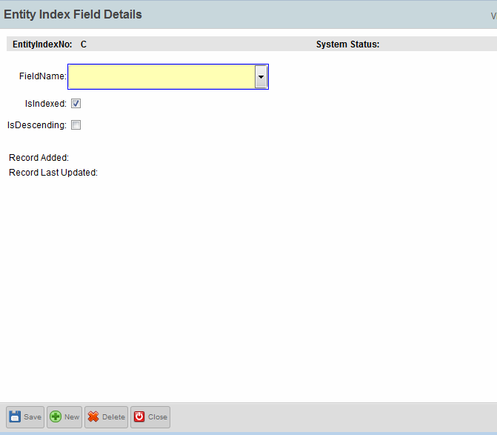
Lesson 5: Entity Configuration - Entity Index Search
Step 2: Fill up the mandatory fields marked in “Yellow”, complete the steps shown, Save -> Activate.
Click here
Select the attribute from the list for the entity who want to have an index. The attribute selected will be indexed.
Save
Notes:
One all mandatory fields are populated, click on Save and then Activate

Slide 5
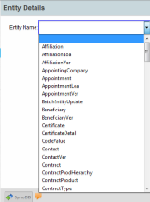
Lesson 5: Entity Configuration - Entity Details
Used to create/modify attributes for the PMPRO entities except the “Standard Fields”.
“Standard Fields” are system defined fields designed by Callidus, which is not shown here and cannot be modified.
Step 1:
Select from the list.
Notes:
Select specific Entity to be configured

Slide 6
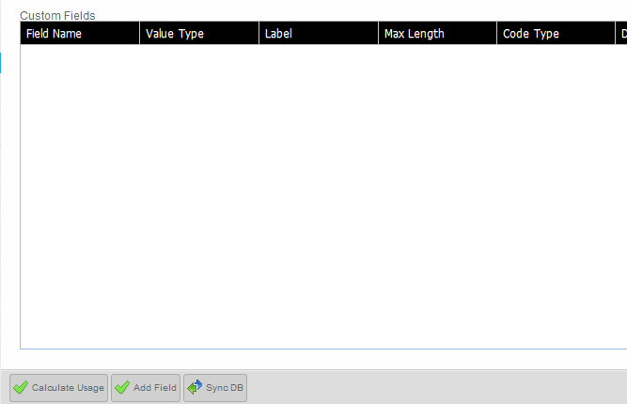
Lesson 5: Entity Configuration - Entity Details
Step 2: After completion of Step 1.
Click on Activate, after Save and Run “SyncDB*” which is mandatory to add the field into database. Unless “SyncDB*” is executed the new attribute will not get reflected into the DB.
Add Field
*SyncDB
Notes:
SyncDB is mandatory to add the field into database.

Slide 7
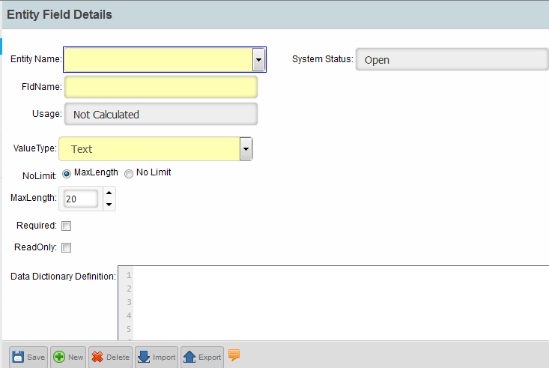
Lesson 5: Entity Configuration - Entity Details
Entity List
Step 3:
Attribute Name
Data Type
Save
Notes:
Mandatory fields to be filled in

Slide 8
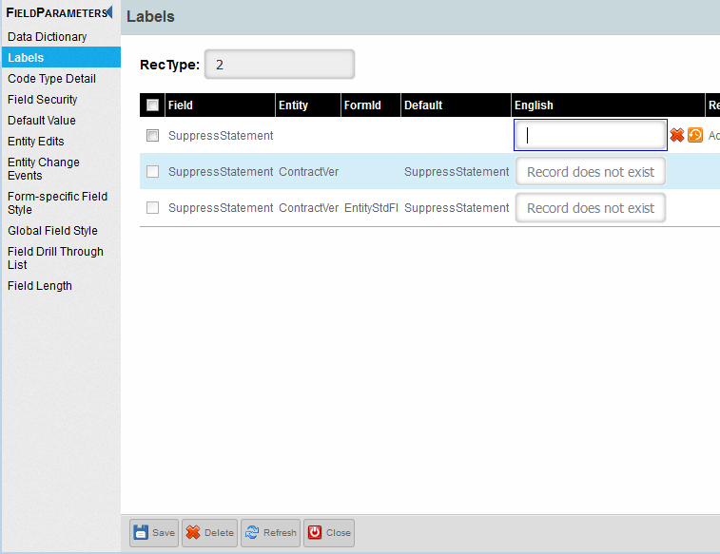
Lesson 5: Entity Configuration - Entity Details
Step 4: To rename the DB name as per UI view.
Save
Notes:
Entity DB name can be changed from UI

Slide 9
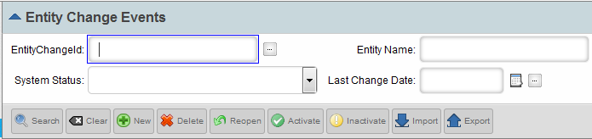
Lesson 5: Entity Configuration-Entity Change Events
Entity Change Event(ECE):
Used to execute SQL scripts based on the below conditions/requirements.
  Calls SQL query for any event to be executed on the UI WS.
  It works on Insert, Update or both and on Delete too.
  It can work on selected fields on Update.
New
Search
Notes:
Let’s now understand, how Entity Change Events can be created

Slide 10
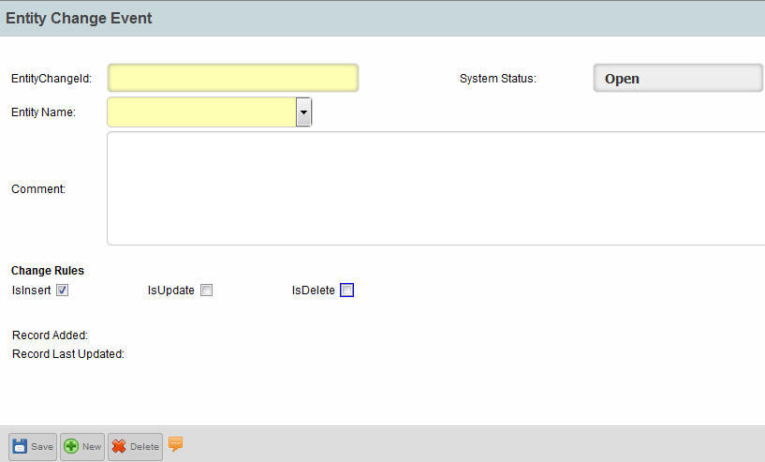
Lesson 5: Entity Configuration-Entity Change Events
Step 1:
Entity Name selection
Notes:
Fill in all mandatory fields

Slide 11
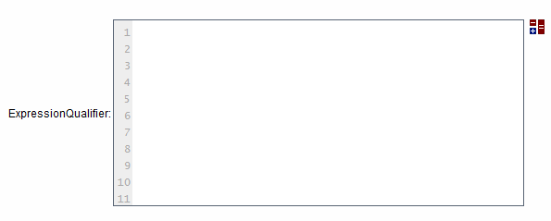

Lesson 5: Entity Configuration-Entity Change Events
Step 2: Same as “Entity Edit” Tutorial
Save
Notes:
Creation of expression qualifier is same as “Entity Edit” lesson.

Slide 12

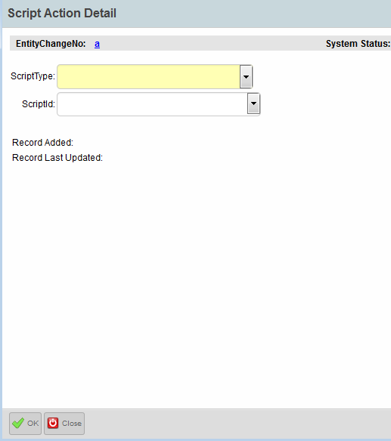

Lesson 5: Entity Configuration-Entity Change Events
Step 3: Add the SQL Script
Click on the link
Type of Script:
SQL
Groovy
Script that need to be called
Activate
Notes:
Now we can learn, how SQL scripts can be added in ECE

Slide 13
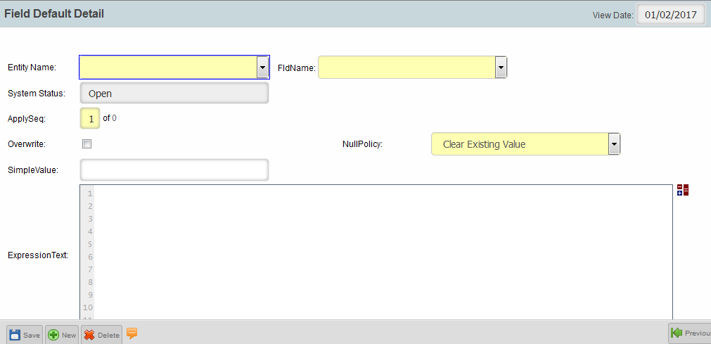
Lesson 5: Entity Configuration – Field Defaults
For any field level constraints/restrictions as per business need.
Note – Fields defaults once created cannot be deleted.
Step 1:
Click to written Expression in a different window.
Notes:
Now let’s understand how field defaults can be created

Slide 14
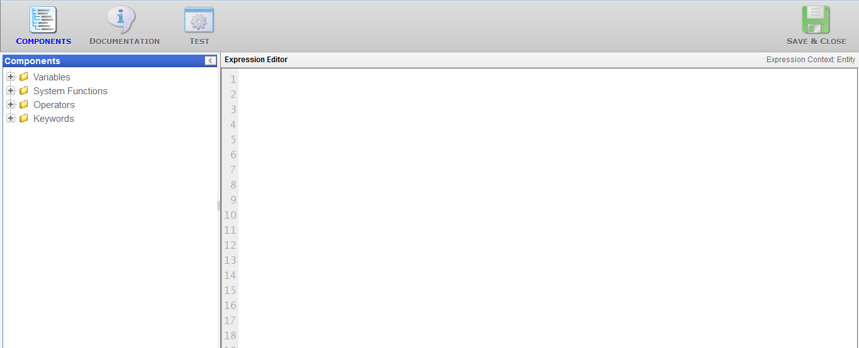
Lesson 5: Entity Configuration – Field Defaults
Step 2:
Choose Attributes for the Entity chosen, add functions, operation and keywords as provided from left pane as per business needs.
Notes:
In order to create expression qualifier, select proper attribute, functions and operation from left pane

Slide 15
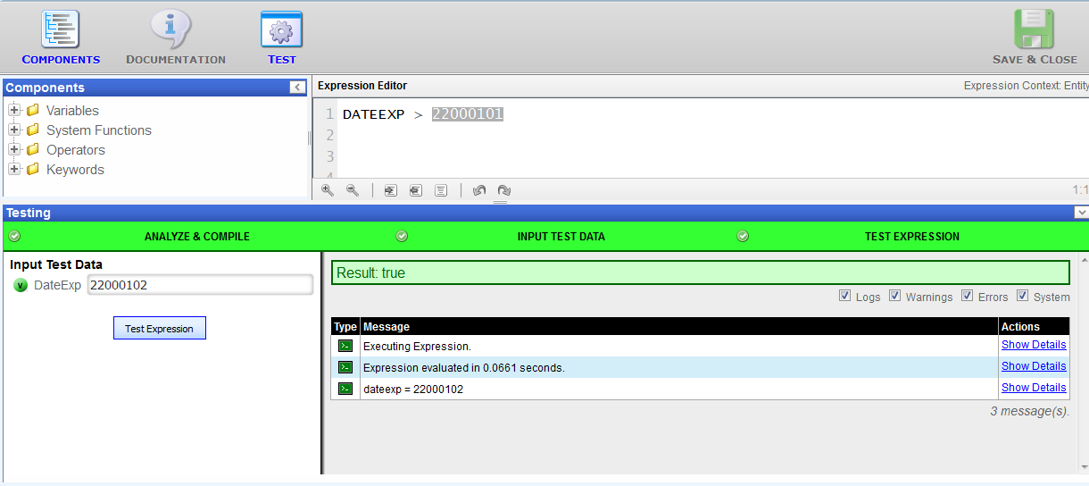
Lesson 5: Entity Configuration – Field Defaults
Step 3:
Click on Test for expression testing.
If the color is “Green” and the output is as expected then the Expression can be Save -> Activate.
Activate
Notes:
Once expression qualifier is written, it can be tested as specified here

Slide 16
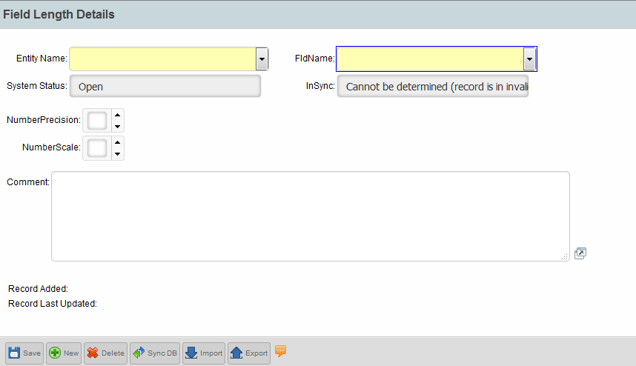
Lesson 5: Entity Configuration – Field Length Details
For any field length modification.
Notes:
Let’s now understand, how entity field length can be modified

Slide 17
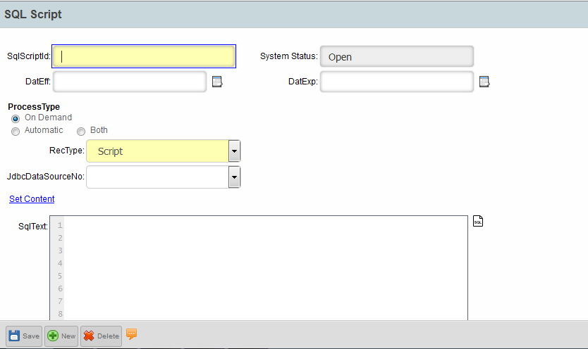
Lesson 5: Processing Configuration – SQL Scripts
For On Demand Script
Write the SQL code here
Notes:
Let’s now understand, how SQL scripts can be created

Slide 18
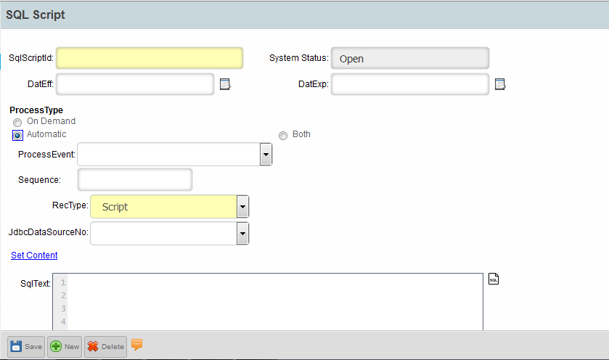
Lesson 5: Processing Configuration – SQL Scripts
For Automatic Script
Sequence is mandatory for Automatic Process Type
Write the SQL code here
Notes:
Sequencing of SQL script, is an important feature

Slide 19
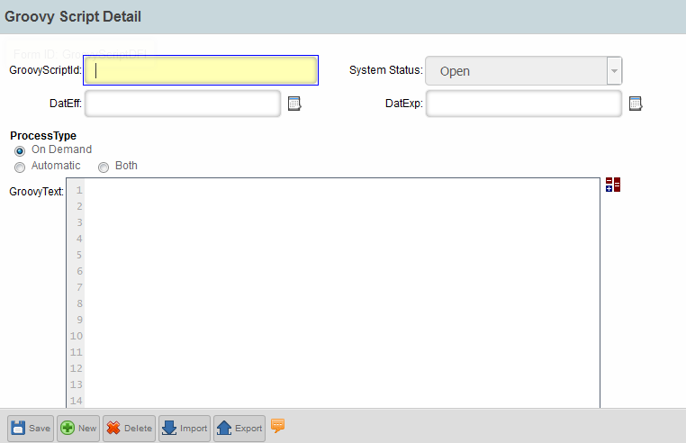
Lesson 5: Processing Configuration – Groovy Script
For On Demand Script
Write the SQL code here
Notes:
Let’s now understand, how Groovy scripts can be created

Slide 20
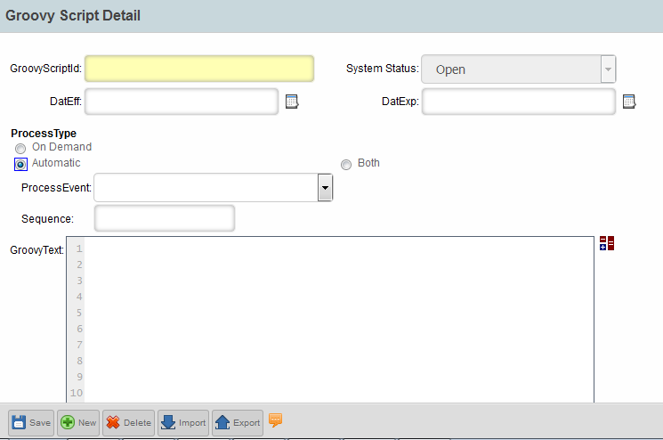
Lesson 5: Processing Configuration – Groovy Script
For Automatic Script
Sequence is mandatory for Automatic Process Type
Write the SQL code here
Notes:
Sequencing of Groovy script, is an important feature

Slide 21
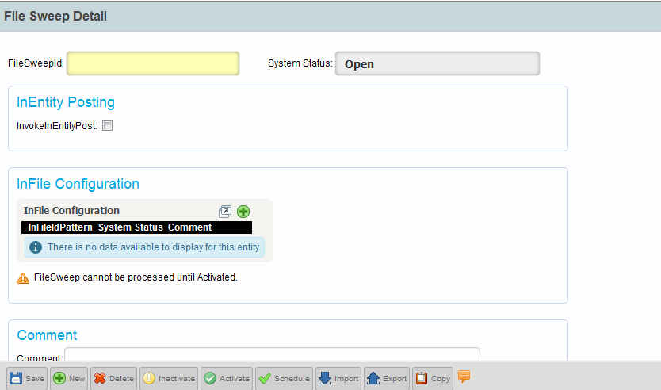
Lesson 5: Processing Configuration – File Sweep
For File Sweep Search – Used to schedule files for load into staging area.
Step 1:
Click to add new configuration
Notes:
Let’s now understand, how File Sweep process can be created

Slide 22
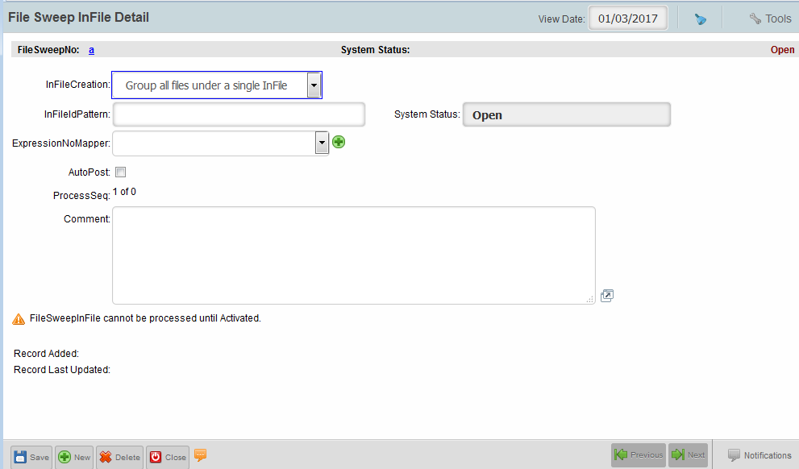
Lesson 5: Processing Configuration – File Sweep
Type of InFile to be created
If Checked gives an option whether or not to continue posting during import error.
Input file pattern
Save
Notes:
File Sweep is required to import any file automatically

Slide 23

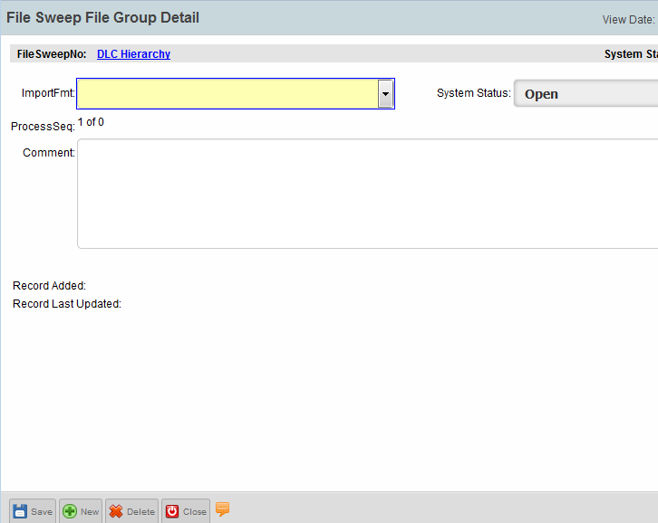
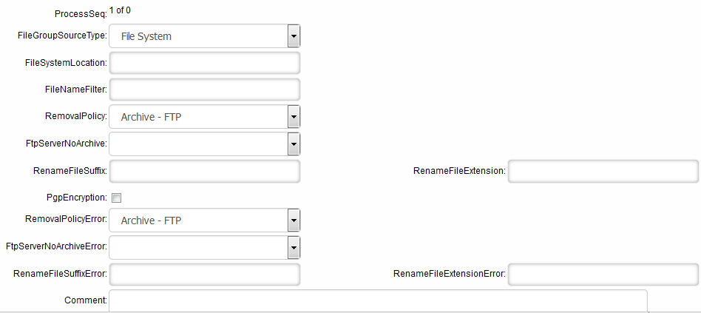
Lesson 5: Processing Configuration – File Sweep
Step 3:
Click to Add
Choose from ImportFmt
Notes:
Select the Import File that needs to be scheduled

Slide 24
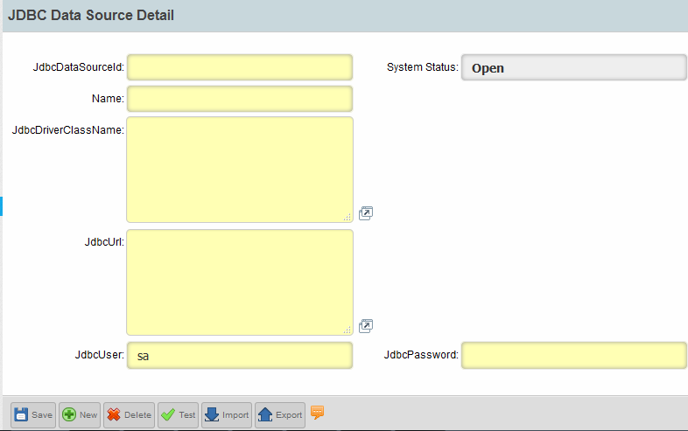
Lesson 5: Processing Configuration – JDBC Data
To create a JDBC connection.
Test
Notes:
Let’s now understand, how JDBC connection can be created

Slide 25
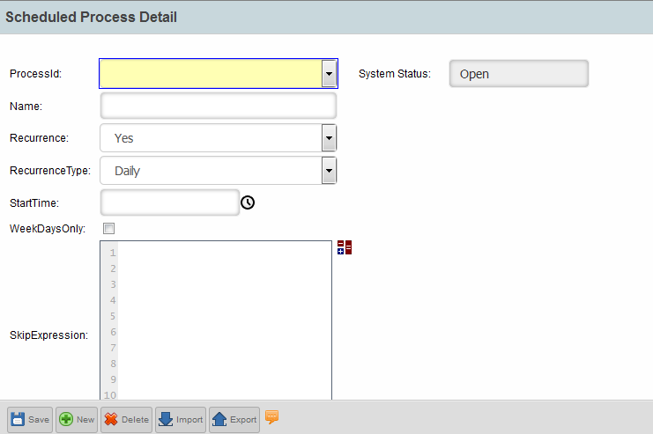
Lesson 5: Processing Configuration – Schedule
To schedule a process, hover on the fields for further inputs.
Notes:
Schedule is the process by which jobs can be scheduled

Slide 26
Test Your Understanding
  From where do we add attributes/fields?

Slide 27
Test Your Understanding
  Both standard and custom fields are editable.

Slide 28
Test Your Understanding
  A process can be scheduled from both File Sweep Search as well as Scheduled Processes.

Slide 29
Test Your Understanding
  Can SQL script call PL/SQL block

Slide 30
Test Your Understanding
  How many type of “Process Type” does a script have?

Slide 31

Summary
You should now be able to comprehend:
  Usage of Field Defaults, ECE etc.
  How to write SQL scripts?
  Difference between SQL and Groovy scripts
  Concept of File Sweep and Scheduler.
Notes:
You should now be able to comprehend
Usage of Field Defaults, ECE etc.
How to write SQL scripts?
Difference between SQL and Groovy scripts
Concept of File Sweep and Schedular.

